Slide 1

4
A Guide to MySQL

Slide 2
Objectives
Retrieve data from a database using SQL commands
Use compound conditions in queries
Use computed columns in queries
Use the SQL LIKE operator
Use the SQL IN operator
Sort data using the ORDER BY clause

Slide 3
Objectives (continued)
Sort data using multiple keys and in ascending and descending order
Use SQL aggregate functions
Use subqueries
Group data using the GROUP BY clause
Select individual groups of data using the HAVING clause
Retrieve columns with null values

Slide 4
Constructing Simple Queries
Query: question represented in a way that the DBMS can understand
To implement in MySQL, use SELECT command
No special formatting rules

Slide 5
Constructing Simple Queries (continued)
SELECT-FROM-WHERE statement:
  SELECT columns to include in result
  FROM table containing columns
  WHERE any conditions to apply to the data

Slide 6
Retrieving Certain Columns and All Rows
Use SELECT command to retrieve specified columns and all rows; e.g., list the number, name and balance of all customers
No WHERE clause needed, because all customers are requested

Slide 7
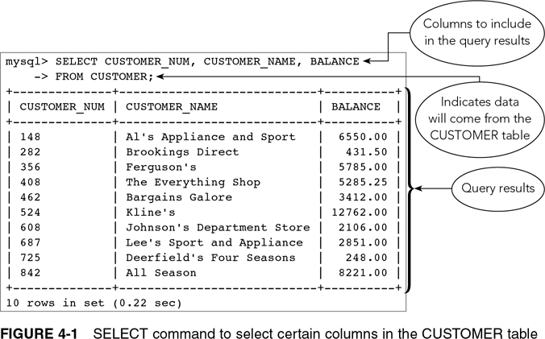
Retrieving Certain Columns and All Rows (continued)

Slide 8
Retrieving All Columns and All Rows
Use an asterisk (*) to indicate all columns in the SELECT clause
Will list all columns in the order used when table was created
List specific columns in SELECT clause to present columns in a different order

Slide 9
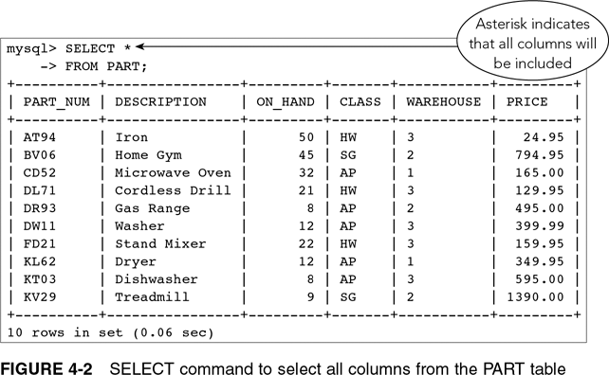
Retrieving All Columns and All Rows (continued)

Slide 10
Using a WHERE Clause
WHERE clause:
  Used to retrieve rows that satisfy some condition
  What is the name of customer number 148?
Simple condition: column name, comparison operator followed by either a column name or a value

Slide 11
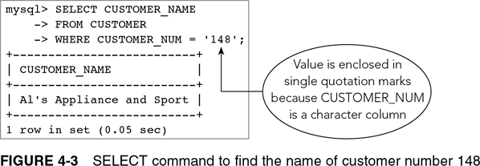
Using a WHERE Clause (continued)

Slide 12
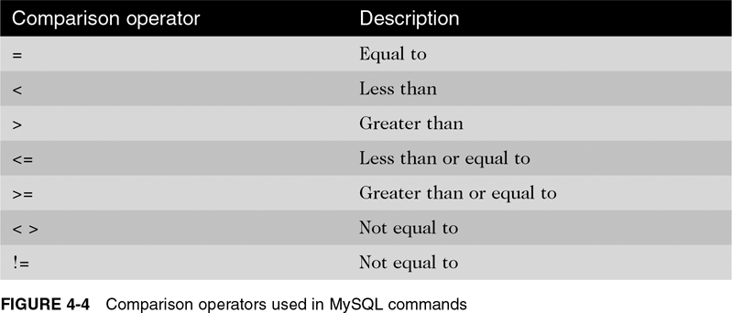
Using a WHERE Clause (continued)

Slide 13
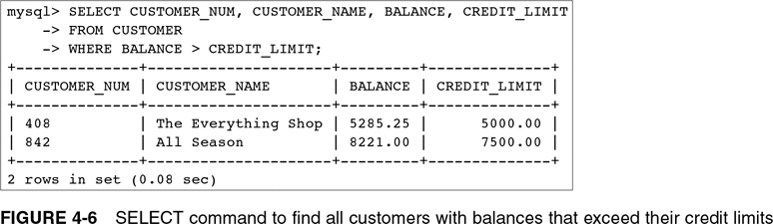
Using a WHERE Clause (continued)

Slide 14
Using Compound Conditions
Compound condition: connects two or more simple conditions with AND, OR, and NOT operators
AND operator: all simple conditions are true
OR operator: any simple condition is true
NOT operator: reverses the truth of the original condition

Slide 15
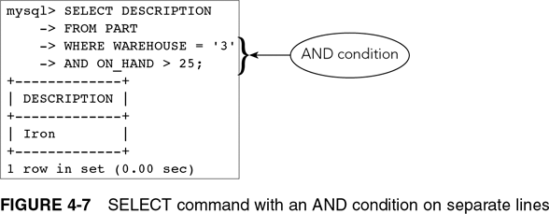
Using Compound Conditions (continued)

Slide 16
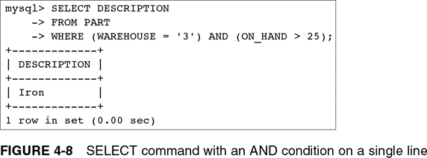
Using Compound Conditions (continued)

Slide 17
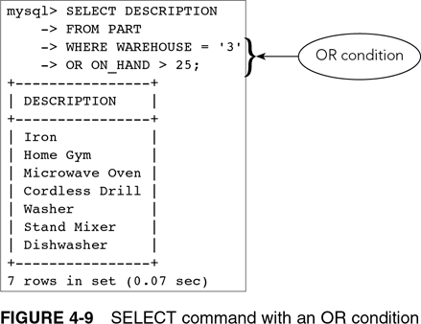
Using Compound Conditions (continued)

Slide 18
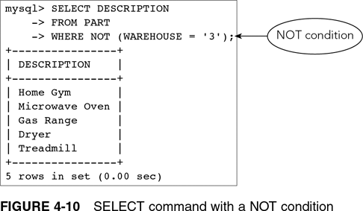
Using Compound Conditions (continued)

Slide 19
Using the BETWEEN Operator
Use instead of AND operator
Use when searching a range of values
Makes SELECT commands simpler to construct
Inclusive: when using BETWEEN 2000 and 5000, values of 2000 or 5000 would be true

Slide 20
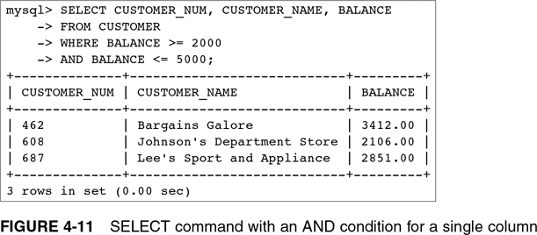
Using the BETWEEN Operator (continued)

Slide 21
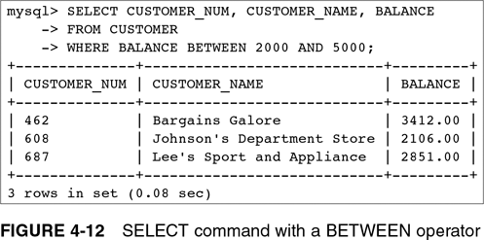
Using the BETWEEN Operator (continued)

Slide 22
Using Computed Columns
Computed column: does not exist in the database but is computed using data in existing columns
Arithmetic operators:
  + for addition
  - for subtraction
  * for multiplication
  / for division

Slide 23
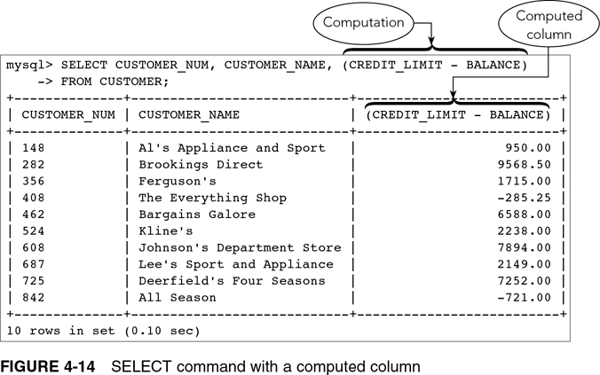
Using Computed Columns (continued)

Slide 24
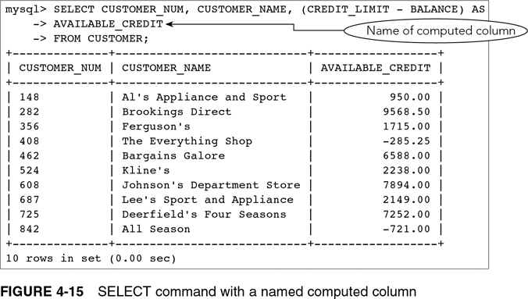
Using Computed Columns (continued)

Slide 25
Using the LIKE Operator
Used for pattern matching
LIKE %Central% will retrieve data with those characters; e.g., “3829 Central” or “Centralia”
Underscore (_) represents any single character; e.g., “T_M” for TIM or TOM or T3M

Slide 26
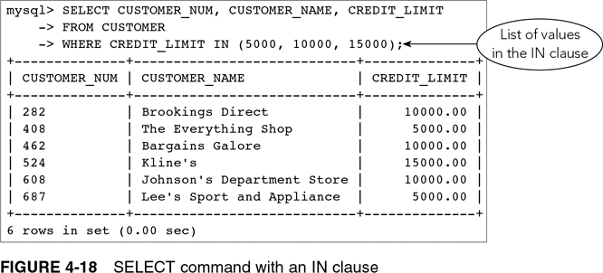
Using the IN Operator

Slide 27
Sorting
By default, no defined order in which results are displayed
Use ORDER BY clause to list data in a specific order

Slide 28
Using the ORDER BY Clause
Sort key or key: column on which data is to be sorted
Ascending is default sort order

Slide 29
Additional Sorting Options
Possible to sort data by more than one key
Major sort key and minor sort key
List sort keys in order of importance in the ORDER BY clause
For descending order sort, use DESC

Slide 30
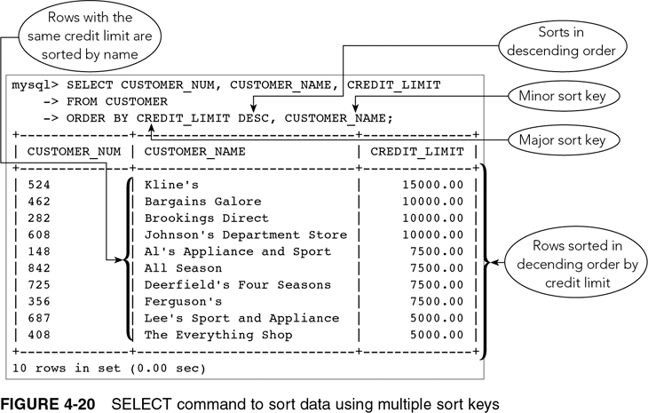
Additional Sorting Options (continued)

Slide 31
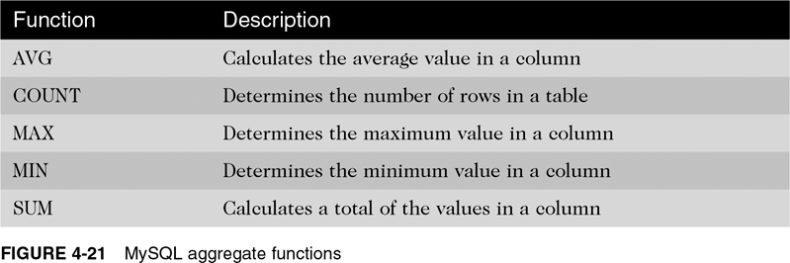
Using Functions

Slide 32
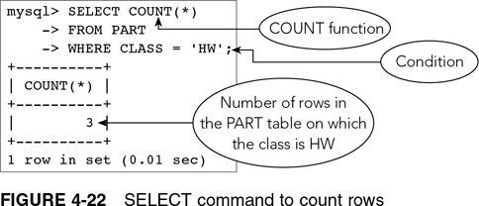
Using the COUNT Function

Slide 33
Using the SUM Function
Used to calculate totals of columns
Column must be specified and must be numeric
Null values are ignored

Slide 34
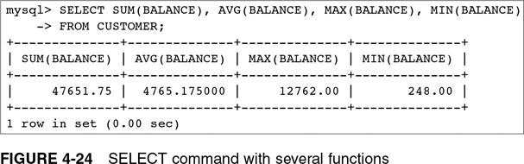
Using the AVG, MAX, and MIN Functions

Slide 35
Using the DISTINCT Operator
Eliminates duplicate values
Used with COUNT function

Slide 36
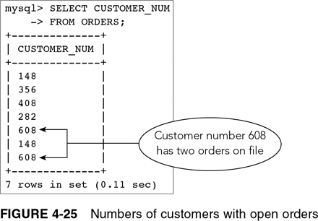
Using the DISTINCT Operator (continued)

Slide 37
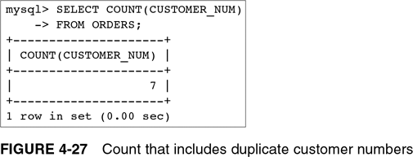
Using the DISTINCT Operator (continued)

Slide 38
Nesting Queries
Query results require two or more steps
Subquery: an inner query placed inside another query
Outer query uses subquery results

Slide 39
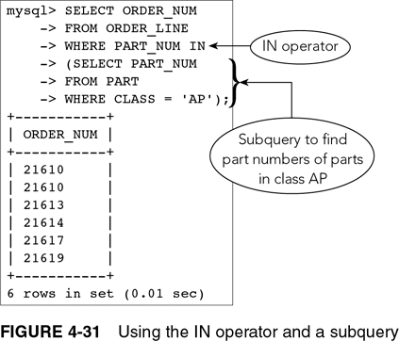
Nesting Queries (continued)

Slide 40
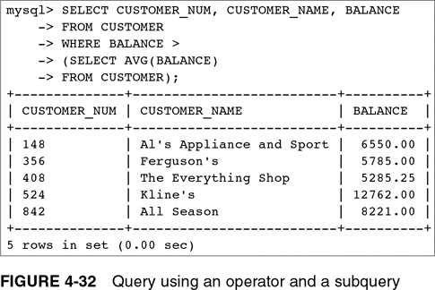
Nesting Queries (continued)

Slide 41
Grouping
Grouping: creates groups of rows that share common characteristics
Calculations in the SELECT command are performed for the entire group

Slide 42
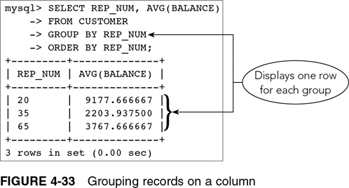
Using the GROUP BY Clause

Slide 43
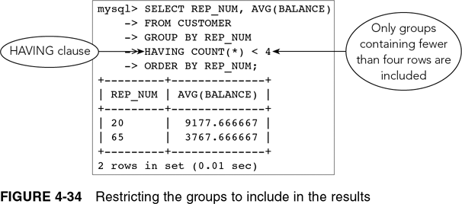
Using a HAVING Clause

Slide 44
HAVING vs. WHERE
WHERE: limit rows
HAVING: limit groups
Can use together if condition involves both rows and groups

Slide 45
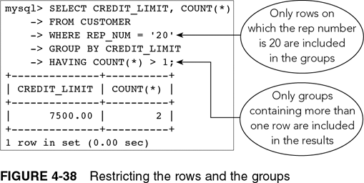
HAVING vs. WHERE (continued)

Slide 46
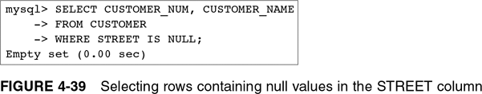
Nulls

Slide 47
Summary
Create queries that retrieve data from a single table using SELECT commands
Comparison operators: =, >,=>,<,=<, or <>, or !=
Compound conditions: AND,OR, and NOT
Use the BETWEEN operator
Use the LIKE operator

Slide 48
Summary
IN operator
ORDER BY clause
Aggregate functions:
  COUNT, SUM, AVG, MAX, and MIN
  DISTINCT operator
Subqueries
GROUP BY
NULL

